Slide 1
LearnMate!
IBM AICTE PROJECT
Presented By:Krovvidi Meenakshi
College Name & Department : Prasad V Potluri Siddhartha Institute of Technology&CSE(AI&ML)

Slide 2
OUTLINE
Problem Statement
Technology used
Wow factor
End users
Result
Conclusion
Git-hub Link
Future scope
IBM Certifications

Slide 3
PROBLEM STATEMENT
Challenge:-
Students often struggle to identify the right learning path that aligns with their interests and long-term goals due to the overwhelming number of online courses and a lack of personalized guidance. LearnMate aims to solve this by acting as an agentic AI coach that interacts with students, understands their interests (such as Frontend Development, Cybersecurity, UI/UX Design, etc.), assesses their current skill level, and dynamically builds a personalized course roadmap. This roadmap adapts over time based on the student's progress, preferences, and evolving goals.
Proposed Solution:- LearnMate! aims to solve this by acting as an Agentic AI coach that interacts with students, understands their interests (such as Frontend Development, Cybersecurity, UI/UX Design, etc.), assesses their current skill level, and dynamically builds a personalized course roadmap. This roadmap adapts over time based on the student's progress, preferences, and evolving goals.

Slide 4
TECHNOLOGY USED
IBM cloud lite services
Natural Language Processing (NLP)
IBM Granite model

Slide 5
IBM CLOUD SERVICES USED
IBM Cloud Watsonx AI Studio
IBM Cloud Watsonx AI runtime
IBM Cloud Agent Lab
IBM Granite foundation model

Slide 6
WOW FACTORS
AI-Powered Personalized Coaching LearnMate acts as a personal AI coach that tailors learning paths based on your goals and skill level, just like a human mentor!
Real-Time Adaptive Learning The agent adjusts the learning journey based on your progress and evolving goals, ensuring a dynamic and responsive experience.
Smart Course Recommendations LearnMate uses AI to recommend courses from top platforms based on your learning style, interests, and career goals.
Instant Feedback & Guidance It offers real-time feedback and motivation, helping you stay on track without needing constant human intervention.
Seamless Integration with Learning Platforms LearnMate pulls in course data from platforms like Coursera or Udemy, giving you a curated and wide variety of courses.
Easy-to-Use AI Interface It’s designed to communicate like a real mentor, with an intuitive conversation flow to ensure a smooth experience.
Continuous Learning & Growth The AI evolves with your learning needs, ensuring you're always presented with the most relevant content as you grow.
Cloud-Backed for Scalability Built on IBM Cloud, the system can scale easily, ensuring it works smoothly for users regardless of their needs or load.

Slide 7
END USERS
Students
Academic Researchers
Research Institutions and Universities
Working Professionals
Online Course Providers
Lifelong Learners

Slide 8
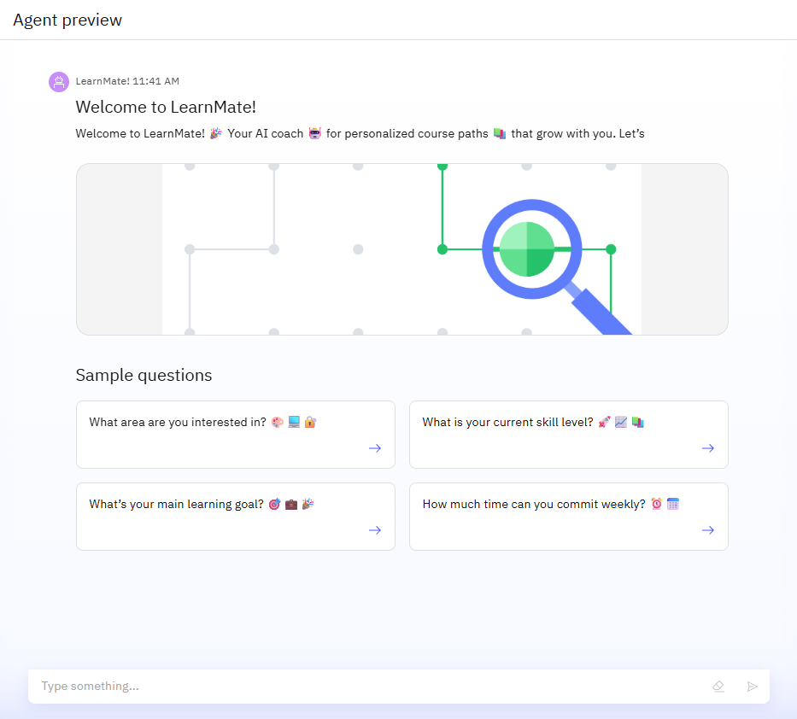
RESULTS

Slide 9
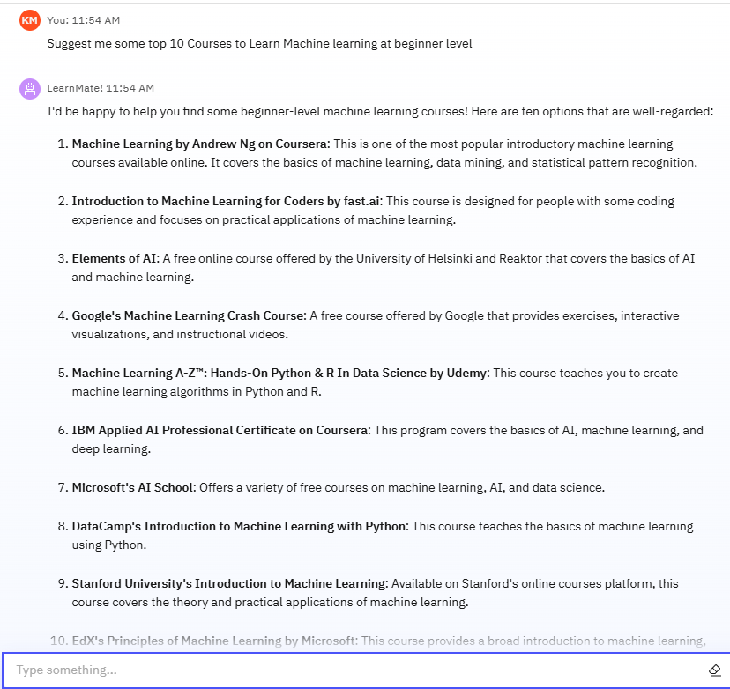
RESULTS

Slide 10
RESULTS

Slide 11
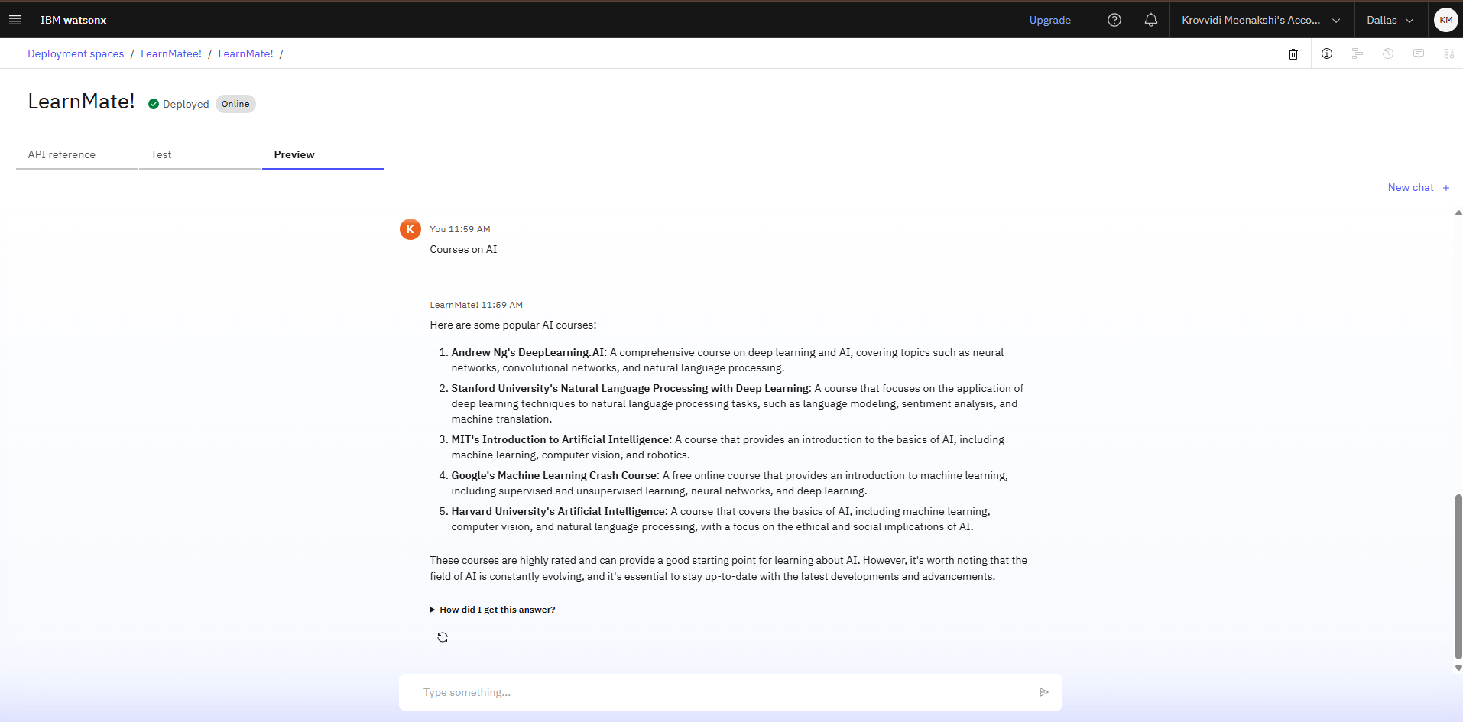
RESULTS
Deployed AI Agent

Slide 12
CONCLUSION
▪ The agent understands student interests, skill levels, and goals to generate personalized course pathways. ▪ It adapts recommendations over time based on user progress and feedback. ▪ LearnMate enhances learning efficiency, clarity, and engagement through real-time AI-guided mentorship.

Slide 13
GITHUB LINK
Make sure that there should be readme file

Slide 14
FUTURE SCOPE
▪ Skill Assessment Integration: Incorporate automated quizzes and coding challenges to better evaluate student proficiency and update learning paths accordingly. ▪ Multilingual Support: Enable interactions in regional languages to increase accessibility for diverse learners. ▪ Career Goal Mapping: Align learning pathways with specific career roles or certifications using real-time job market data. ▪ Integration with LMS & MOOCs: Connect LearnMate with platforms like Coursera, edX, and Udemy for seamless course enrollment and progress tracking. ▪ Real-Time Feedback Loop: Use student feedback and behavior analytics to fine-tune recommendations in real-time. ▪ Voice-Based Interaction: Add conversational voice support for a more interactive and accessible user experience.Voice-Activated Research Assistant

Slide 15
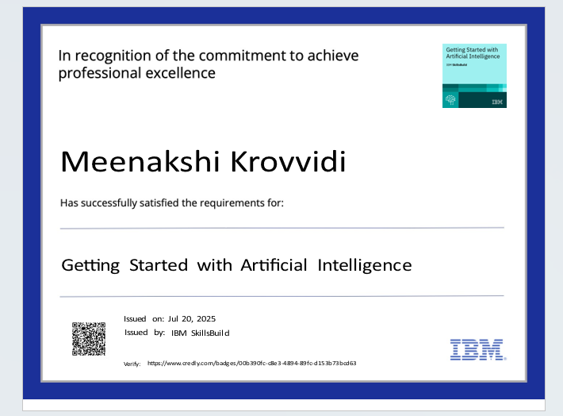
IBM CERTIFICATIONS

Slide 16
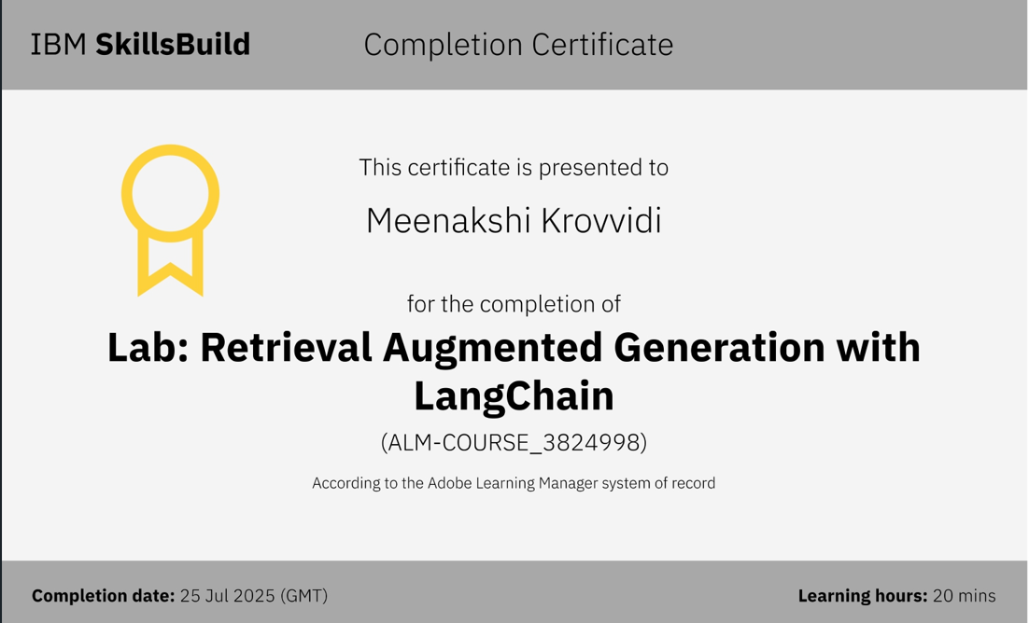

Slide 17
THANK YOU

